Slide 1
March Data Crunch Madness
Team Jumpman:
Yen-Shao Chou
Xueqing Jin
Hengda Shen
Zhihan Yang

Slide 2
Overview
Introduction
Data description
Methodology
Data preprocessing
Model
Evaluation
Interesting results

Slide 3
Introduction
The NCAA Men’s Basketball Tournament, a.k.a. March Madness, is held every spring in U.S. with 68 college basketball teams to determine the national championship.
In March Data Crunch Madness, teams predict the probability that a team wins in all possible matchups. Since March Madness was cancelled in 2020, there will be no Logloss as evaluation. Historical data was given and teams were encouraged to modify the dataset from sources.

Slide 4
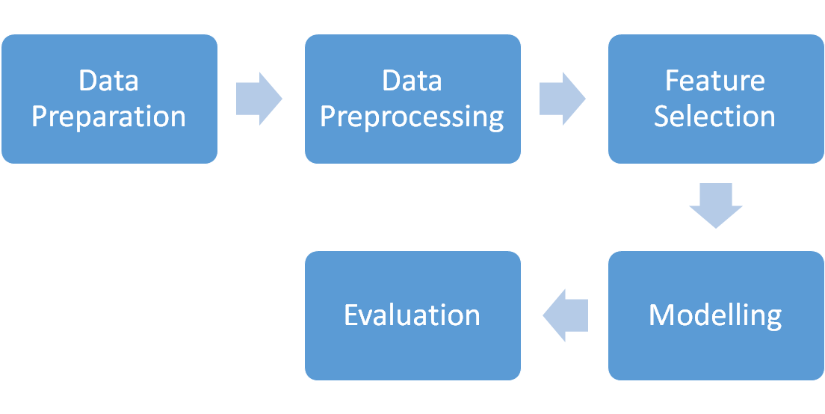
Methodology

Slide 5
Data preparation
Dataset:
NCAA_Tourney_2002_2019, Team_RPI, Team_SOS, Team_MasseyOrdinals
Data sources
Team_RPI(Rating percentage index): teamrankings.com
Team_SOS(Strength of schedule): kenpom.com
Team_MasseyOrdinals: A ranking system from masseyratings.com

Slide 6
Data preprocessing
We merged datasets we crawled online, namely Team RPI, Team_SOS and Team_MasseyOrdinals to the given dataset
We shuffled the positions of team1 and team2 and their stats accordingly to produce balanced results
We generated new features by subtracting the team2 game stats from team1
We handled the missing values

Slide 7
Features selection
Variance Inflation factor (VIF)
Examine the multi-collinearities of features
Tree-based feature selection
Analyze the factor importances of features
L1 - Regularization
Remove insignificant features

Slide 8
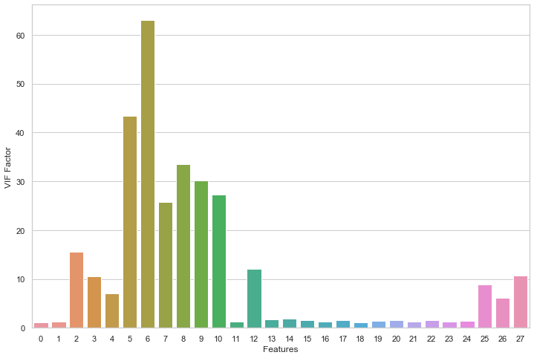
Variance Inflation Factor
We removed features with VIF greater than 10 one by one and re-run VIF testing to ensure least multicollinearity and max explainability
Figure 1. VIF

Slide 9
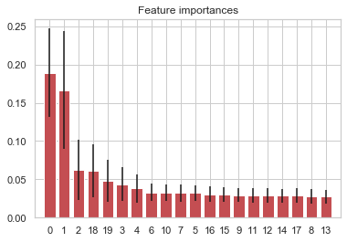
Tree - Based Feature Selection
Method: ExtraTreeClassifier from Scikit-Learn
Top 5 features:
1. Seed
2. rpi
3. Massey Ordinals
4. Adjusted Offensive efficiency
5. Adjusted Defensive efficiency
We keep the top 15 features
Figure 2: Feature Importance

Slide 10
L1 Regularization
Also known as Lasso Regression
Lasso Regression adds “absolute value of magnitude” of coefficient as penalty term to the loss function so the coefficient of less important features will be zero.
We get rid of the insignificant features

Slide 11
Features-Top 5
Features | Description
Seed | Team’s seed in the tournament. There are 4 brackets of teams seeded 1 through 16.
RPI | The rating percentage index is a quantity used to rank sports teams based upon a team's wins and losses and its strength of schedule.
Massey Ordinals | The ratings are totally interdependent, so that a team's rating is affected by games in which it didn't even play. The final ratings represent a state of equilibrium in which each team's rating is exactly balanced by its good and bad performances.
Adjusted Offensive efficiency | An estimate of the offensive efficiency (points scored per 100 possessions) a team would have against the average D-I defense.
Adjusted Defensive efficiency | An estimate of the defensive efficiency (points allowed per 100 possessions) a team would have against the average D-I offense
Listed features after filtering were most important

Slide 12
Modelling
We utilized an Ensemble Model with 10-folds Cross Validation
Lightgbm (weight = 0.3)
XGboost (weight = 0.7)
To determine the optimized weight, we iterated and evaluated the ensemble model

Slide 13
Evaluation
 | Log Loss | Overall F1 - score
Lightgbm | 0.442 | 0.80
XGboost | 0.442 | 0.80
Logistic Regression | 0.517 | 0.75
Ensemble | 0.442 | 0.81
We splitted three seasons (17, 18, 19) as our testing set.
We included Logistic Regression as a comparison
Overall precision of the ensemble model is around 80%.

Slide 14
Region Overview
The table gives the average winning probability of seed-one teams versus the other teams in the same region respectively
Region | Mean Win_prob
W (South) | 0.878
X (East) | 0.858
Y (Midwest) | 0.921
Z (West) | 0.868
Since the Mean Win_prob of region Y is much higher, and other teams of Y are also competitive according to the history. We present that seed-one of region Y, namely Kansas has a high chance of winning Final Four, or even Championship

Slide 15
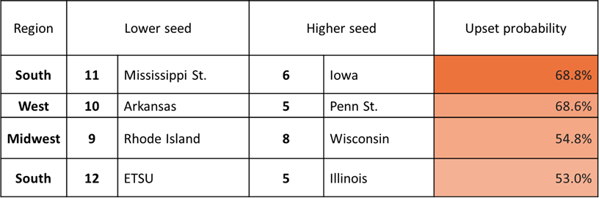
Upsets
Upsets predicted by our model for the first round
Our model suggested that there would be 4 upsets in 2020. Mississippi State(11th) has the highest probability to win as a underdog against Iowa(6th).
East Tennessee State was predicted to win as a underdog with the largest seed difference.

Slide 16
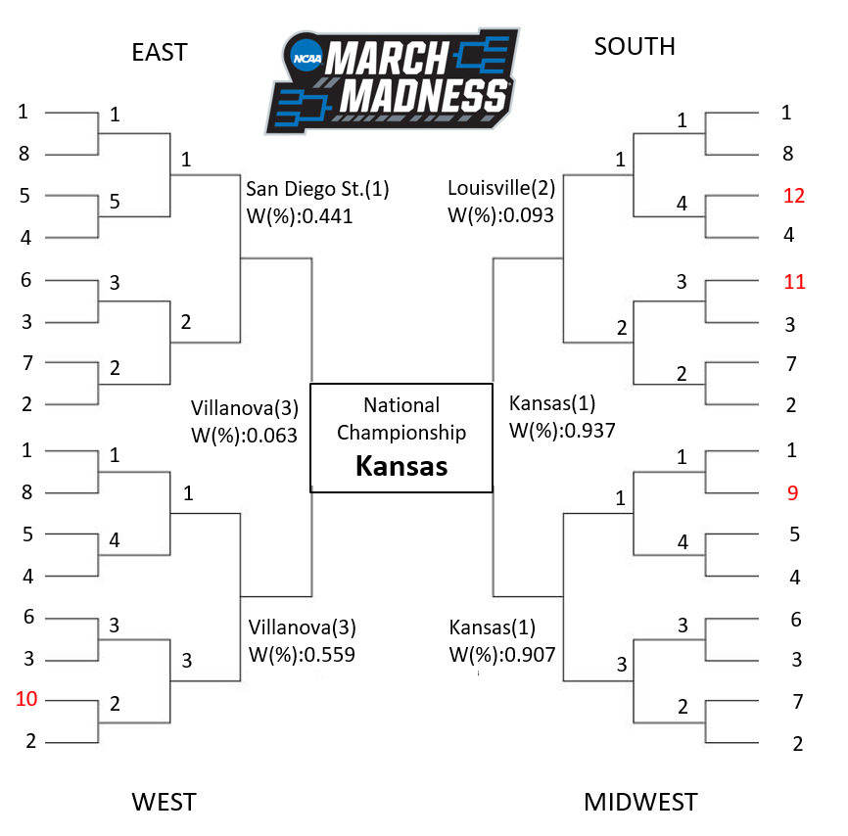
Championship prediction
The NCAA 2020 bracket of the prediction starts from 2nd round.
We assumed region matchups(E v.s. W, S v.s. M) would be the same as 2019.
Highlighted numbers refers to our predicted upsets in 1st round.
Based on the model, the final four would be San Diego St., Villanova, Louisville, Kansas.
The predicted NCAA 2020 championship is Kansas with a high winning percentage against Villanova, it coincides to we proposed early.

